Slide 1
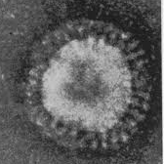
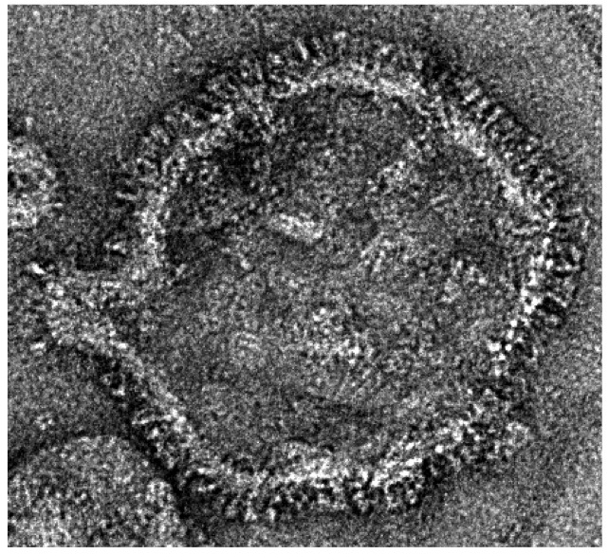
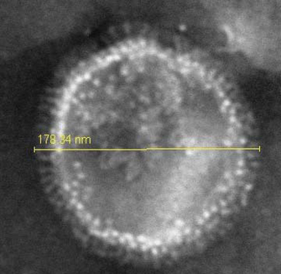
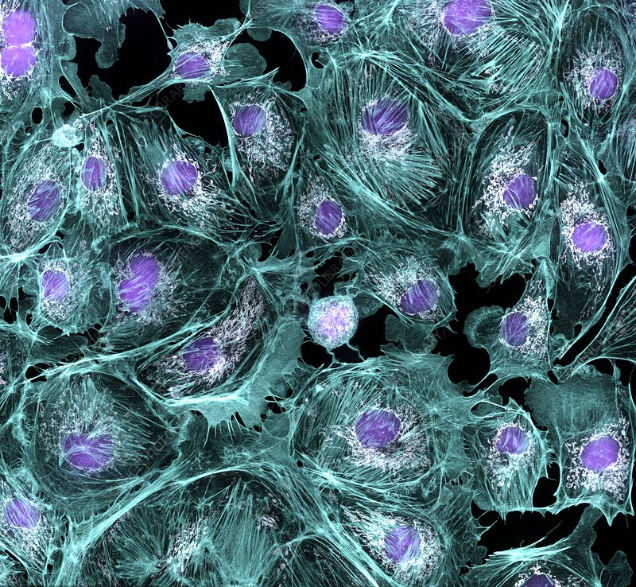
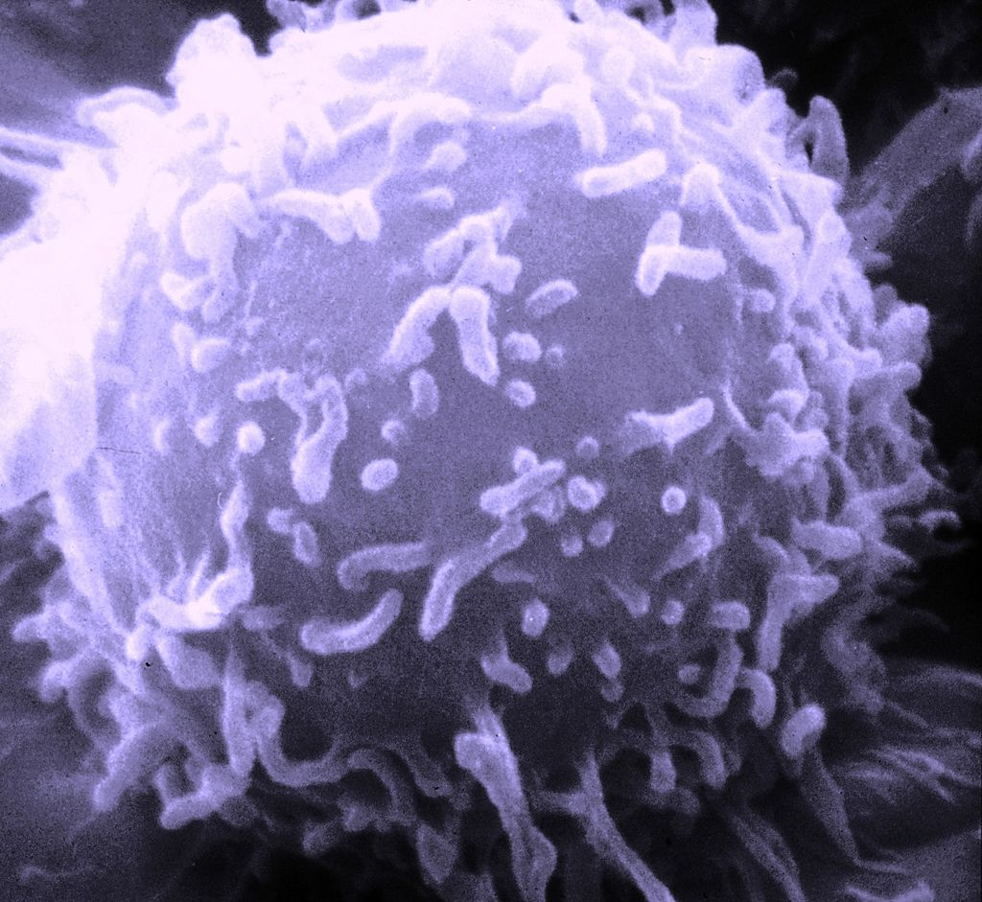
Finding Viral Induced Peptides
sarscov2
RSV
Influenza
Identification of immunogenic alternative open reading frames in differentially expressed genes during viral infection
Arthur Kroon
T cell

Slide 2
Next generation immunoinformatics
Definition of “immunogenic Alternative Open Reading frames”

Slide 3
Viral Induced Peptides and synonyms
Viral induced peptides may be discovered under different names:
Neoantigens
Micropeptides
Alternative Open Reading Frame products ( AltORF)
Small Open Reading Frame (smORF)
Cryptic peptides
Defective ribosomal initiation products (DRIP)
Non-canonical translation products
Damage associated molecular patterns (DAMP)
micro Open Reading Frame (μORF)
non-canonical HLA-binding peptides (noncHLAp)

Slide 4
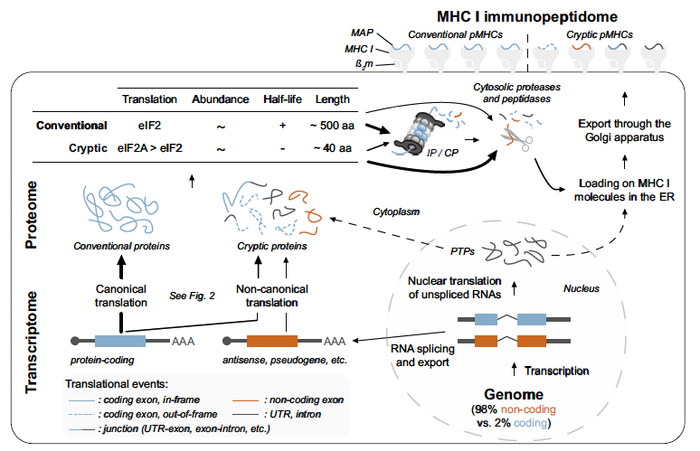
Exploring alternative translation products
Laumont et al. 2018 Cell. Mol. Life Sci. DOI 10.1007/s00018-017-2628-4

Slide 5
Results of a search
"neoantigen" "sars-cov-2": 262
"neoantigen" "covid-19": 1640
"micropeptide" "sars-cov-2": 20
"micropeptide" "covid-19": 83
"altorf" "sars-cov-2": 5
"altorf" "covid-19": 32
"smorf" "sars-cov-2": 2
"smorf" "covid-19": 20
"cryptic peptide" "sars-cov-2": 11
"cryptic peptide" "covid-19": 72
"defective ribosomal initiation products" "sars-cov-2": 0
"defective ribosomal initiation products" "covid-19": 8
"non-canonical translation products" "sars-cov-2": 1
"non-canonical translation products" "covid-19": 1
"damage associated molecular patterns" "sars-cov-2": 852
"damage associated molecular patterns" "covid-19": 2670

Slide 6
Introduction
“The current antiviral strategies do not use complete spectrum of potential targets”
Adaptive vs innate immunity
PAMPs, DAMP and Pattern recognition receptors
Major Histocompatibility Complex (MHC) and Human Leukocyte Antigens (HLA)
Can HLA-I peptides originate from canonical and out-of-frame ORFs ?
AltProts and immune epitopes
datamining with bioinformatics the VIP finder

Slide 7
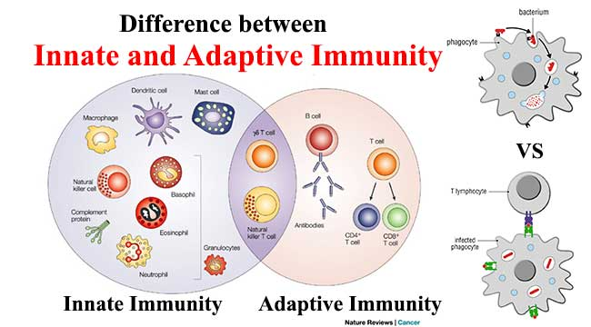
https://microbiologyinfo.com/difference-between-innate-and-adaptive-immunity/

Slide 8
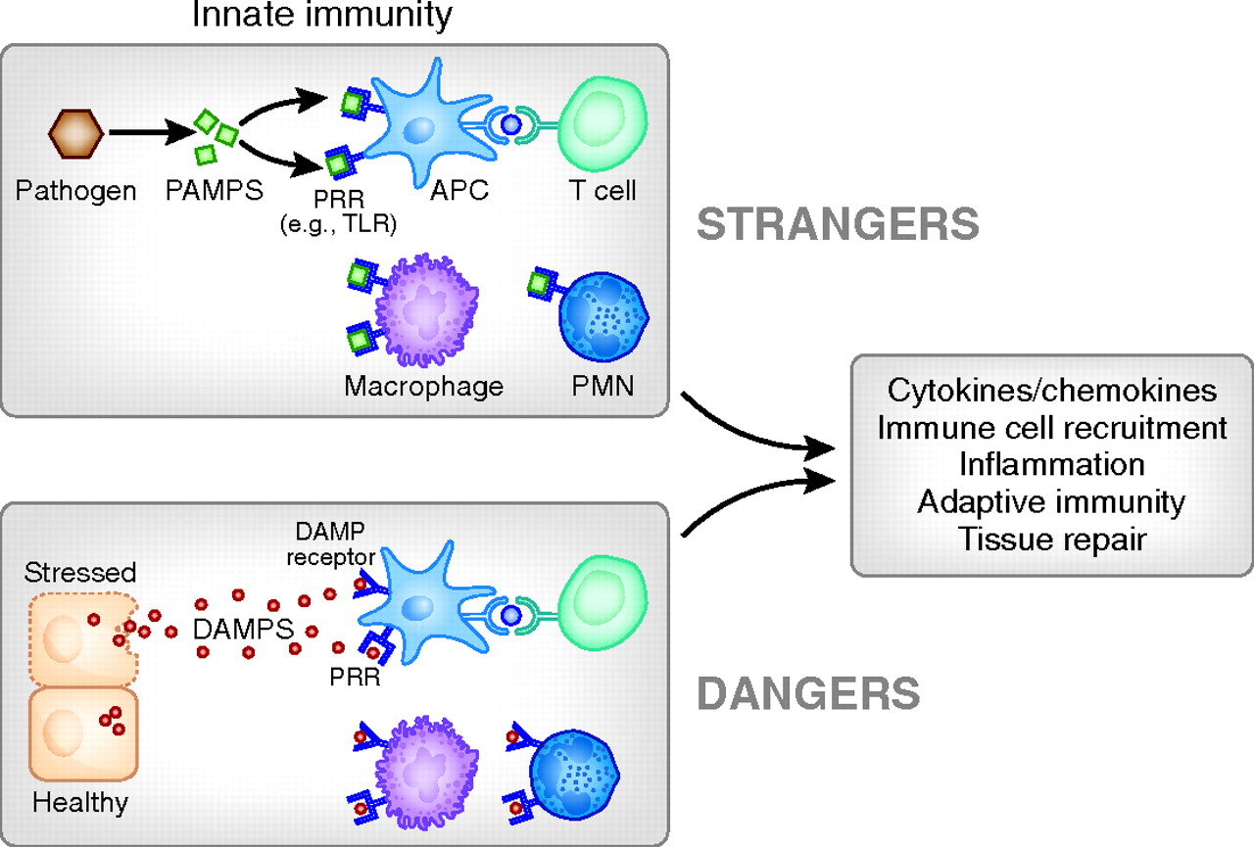
PAMPs and DAMPs
Diane L. Rosin, and Mark D. Okusa JASN 2011;22:416-425

Slide 9
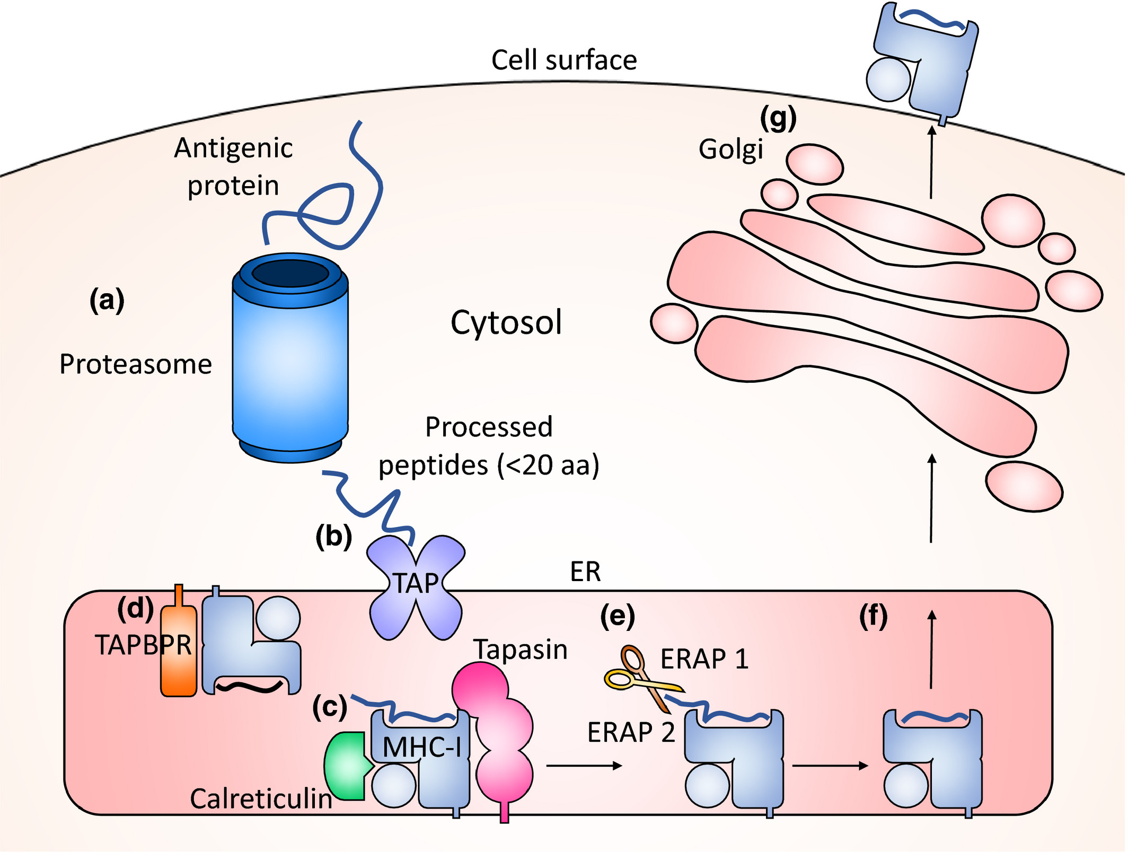
Adaptive immunity is mainly based on human leukocyte antigen (HLA)
(HLA1 in human)
MHC function is to display peptide fragments of proteins from within the cell

Slide 10
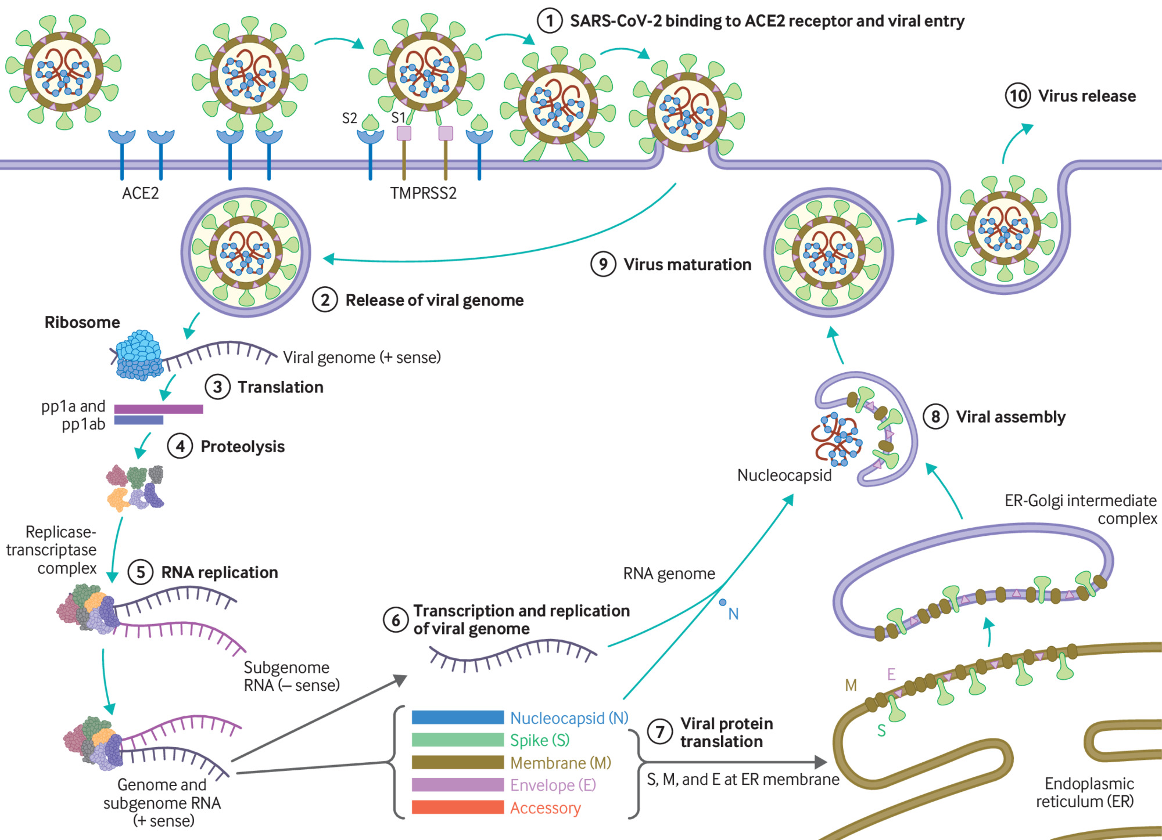
sars cov 2 virions and loaded MHC1 molecules travel similar route ? Do they share in the same type of vesicles ?
https://www.bmj.com/content/371/bmj.m3862

Slide 11
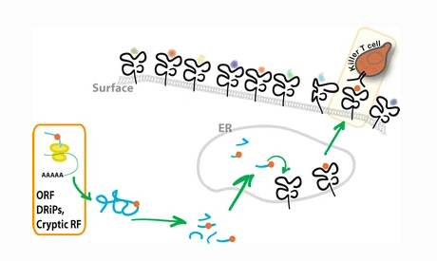
Shelley R. Starck & Nilabh Shastri Cellular and Molecular Life Sciences volume 68, pages1471–1479(2011)

Slide 12
Next generation immunoinformatics
Here we propose a new method to identify cryptic immunogenic peptides originating from translation of novel alternative open reading frames in cells when infected with a virus.
These Viral Induced Peptides (VIP) can be used to diagnose, treat and may be even to prevent disease caused by a broad range of virus infections.
We describe a bioinformatics strategy to find these VIPs with a VIP finder method.
We propose these VIP’s are important for a better understanding of the dynamics between ongoing infection and the immune system

Slide 13
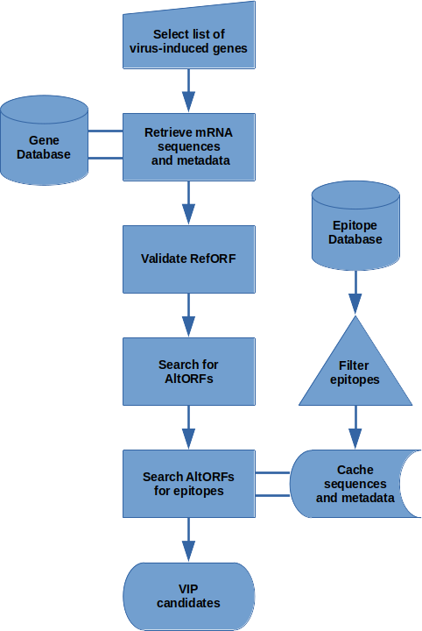
Flow diagram of VIPfinder method
NCBI
Gene Expression Omnibus
>Twofold upregulated mRNA
as deteremined by DEG
Altprot database
Translated AltORF > 10 codons (10 AA)
Immune epitope database
Immune Epitope present in AltPROT (Y/N)

Slide 14
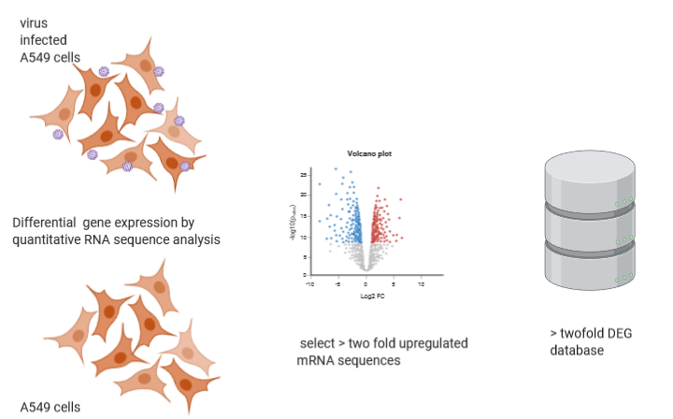
Differential expressed genes during viral infection and direct RNA sequencing
RNA-Seq data can be found on the NCBI Gene Expression Omnibus (GEO), for this experiment under accession number GSE147507
Daniel Blanco-Melo et al. Cell. 2020 May 28; 181(5): 1036–1045

Slide 15
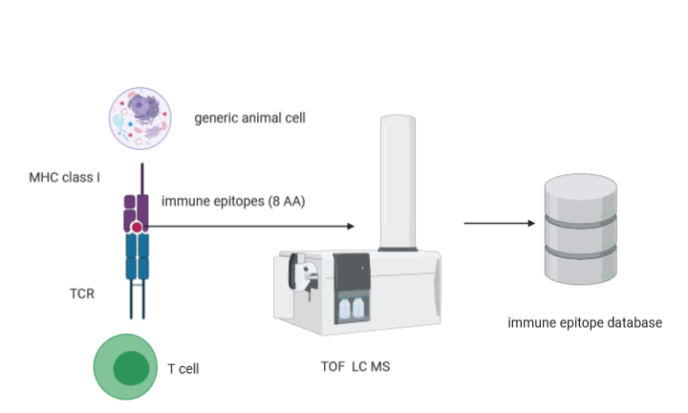
Immune epitope database
An immune epitope is a part of a molecule that is directly recognized by adaptive immune receptors, specifically by antibodies, B cell receptors, or T cell receptors

Slide 16


VIP finder: a new tool to identify and categorize viral induced peptides
We designed a pipeline to identify immunogenic cryptic peptides alternative open reading frames in differentially expressed genes during viral infections
We created lists of VIP’s for three different virus types SARS CoV2, IAV and RSV
>Twofold upregulated mRNA
AltPROT database
AltORF recognition
VIPfinder
AltPROT with immune epitopes: VIP List
Immune epitope database

Slide 17
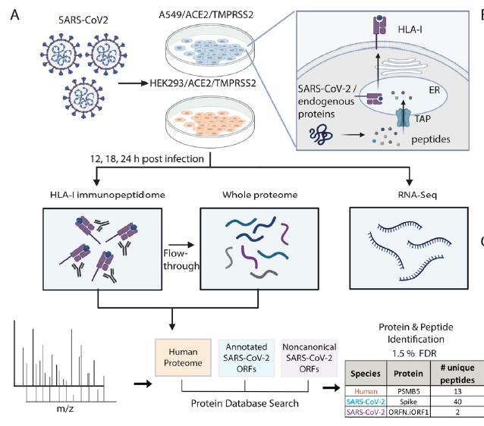
SARS-CoV-2 infected cells present HLA-I peptides from canonical and out-of-frame ORFs
Shira Weingarten-Gabbay et al. 2020 bioRxiv preprint version posted October 2 https://doi.org/10.1101/2020.10.02.324145

Slide 18
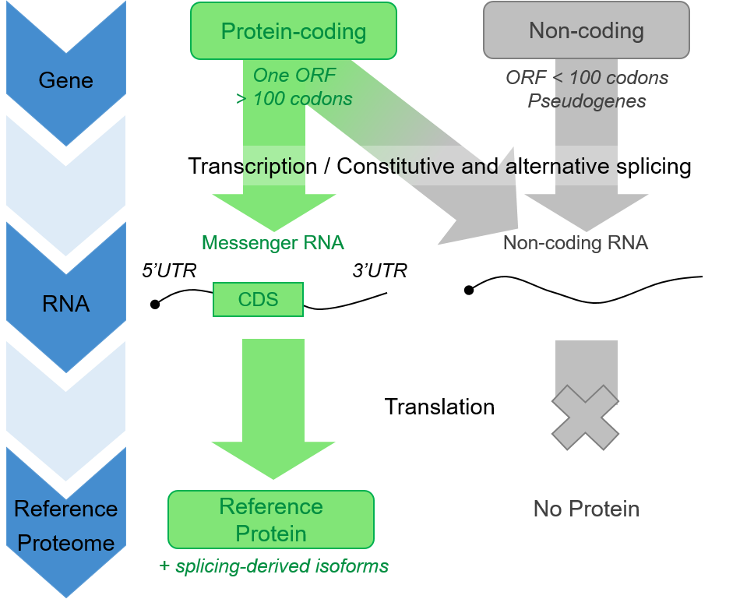
The current annotation model
Current genome annotations hold arbitrary criteria for Open Reading Frame (ORF) annotation, such as:
a minimal ORF length of 100 codons;
a single ORF per transcript (monocistronic);
transcripts that do not meet the above criteria are non-coding (ncRNAs);
transcripts from unprocessed pseudogenes are non-coding (ncRNAs).
With the rare exception of previously characterized examples, these rules are applied and considerably shape the annotated protein landscape (Reference Proteome). Yet, a wealth of experimental data highlights the pitfalls of such annotation model.

Slide 19
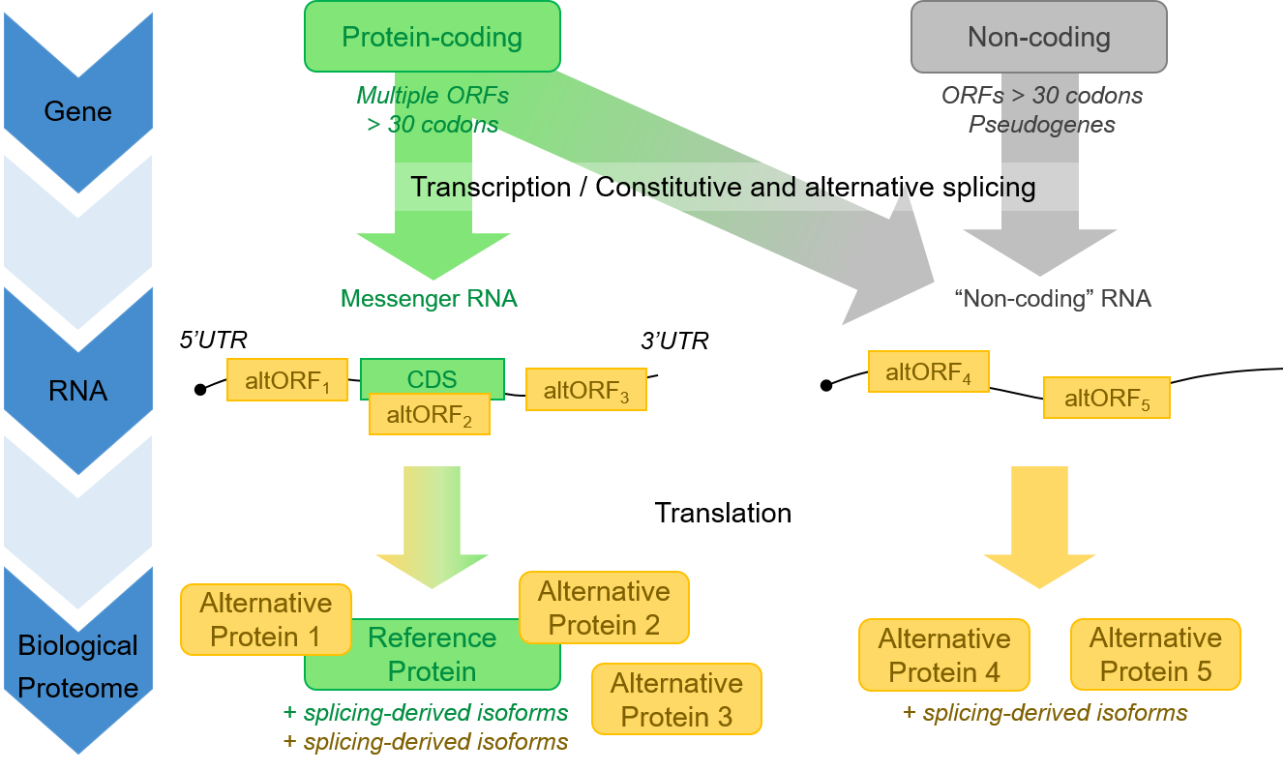
The OpenProt annotation model
OpenProt challenges the aforementioned arbitrary criteria, and thus:
annotates any ORF longer than 30 codons;
annotates multiple ORF per transcript (polycistronic);
annotates ORFs within ncRNAs;
annotates ORFs within pseudogenes transcripts.
Thus OpenProt annotates known proteins (Reference Proteins or RefProts), novel isoforms and novel proteins (Alternative Proteins or AltProts). It offers a deeper, and more realistic, view of the proteome (Biological Proteome).

Slide 20
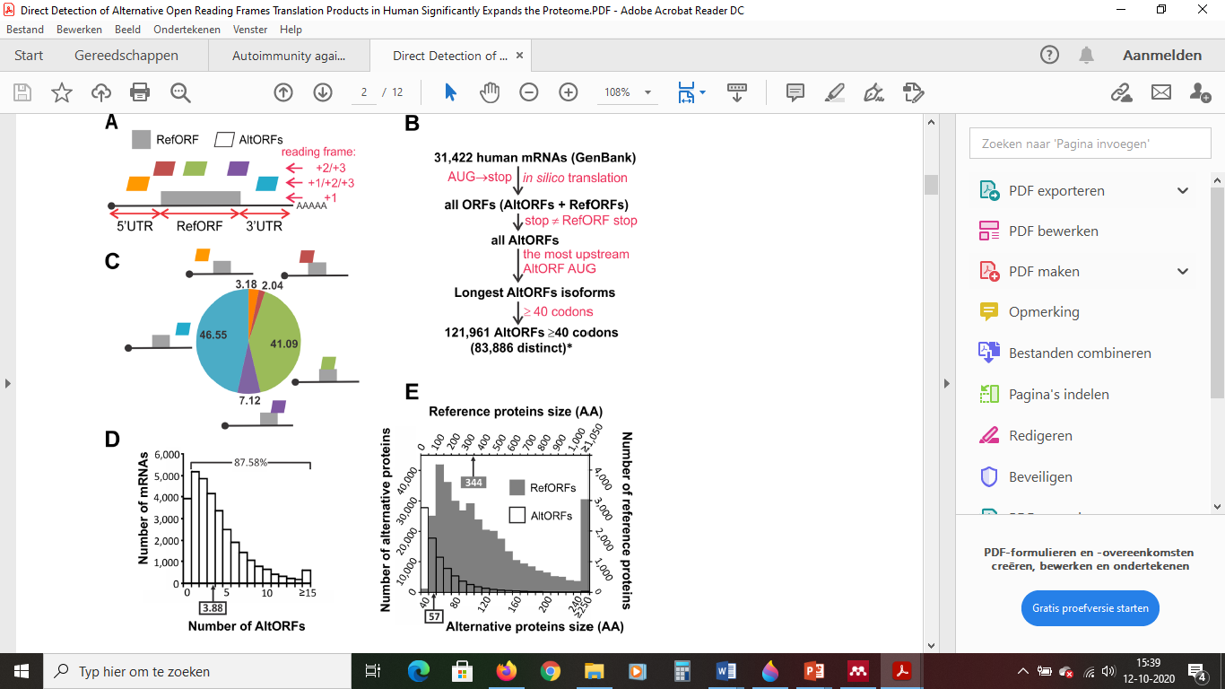
Alternative open reading frames in mRNA
Vanderperre, B., Lucier, J. F., Bissonnette, C., Motard, J., Tremblay, G., Vanderperre, S., … Roucou, X. (2013). Direct Detection of Alternative Open Reading Frames Translation Products in Human Significantly Expands the Proteome. PLoS ONE, 8(8).

Slide 21
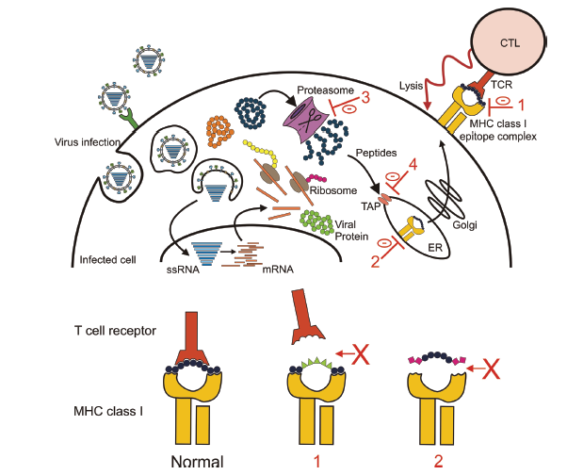
Carolien E. van de Sandt,Viruses 2012, 4, 1438-1476; doi:10.3390/v4091438

Slide 22
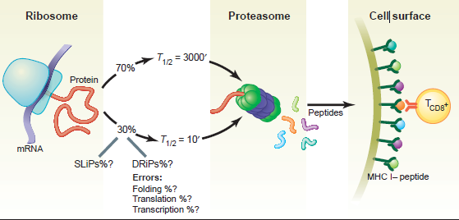
principle of immune epitope generation
Hide and Seek in the Peptidome Jonathan W. Yewdell
Science 301, 1334 (2003)

Slide 23
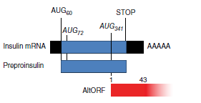
Example of biologically relevant alternative open reading frame product
Ins-DRiP
Kracht, M. J. L., Van Lummel, M., Nikolic, T., Joosten, A. M., Laban, S., Van Der Slik, A. R., … Roep, B. O. (2017). Autoimmunity against a defective ribosomal insulin gene product in type 1 diabetes. Nature Medicine, 23(4), 501–507.

Slide 24
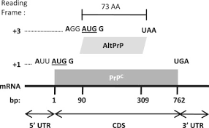
Example of alternative open reading frame product detected with mass spectrometry
AltPrP, a typical example of AltORFs in the HAltORF database.
Vanderperre, B., Lucier, J. F., & Roucou, X. (2012). HAltORF: Adatabase of predicted out-of-frame alternative open reading frames in human. Database, 2012(January). https://doi.org/10.1093/database/bas025
(Vanderperre, Lucier, & Roucou, 2012)

